Slide 1
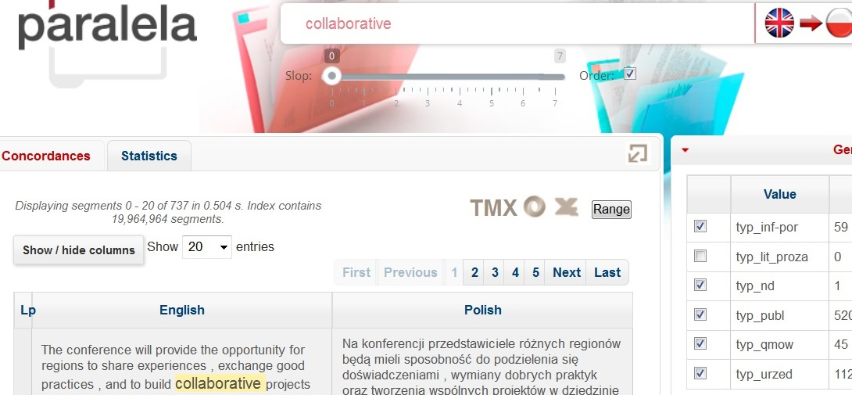
ESP Oxford 2018 ESP university programme for business and media (translation perspective)
Barbara Lewandowska-Tomaszczyk,
State University of Applied Sciences in Konin; University of Lodz

Slide 2
Relationship between ESP, business and media, translation (new BA and MA university programs)
Polish universities (University of Lodz, State University of Applied Sciences in Konin)

Slide 3
Corpora
ESP typically defined as a variety much less vague and indeterminate than general language
In fact, similar cross-linguistic meaning approximation, cluster equivalence patterns, collocational uses (Lewandowska-Tomaszczyk 2017)
Examples technical and legal language on parallel ESP-Polish data - their cluster equivalence patterns and collocational uses (Lewandowska-Tomaszczyk 2017)
NEW BA & MA PROGRAMMES
Tasks involving monolingual and parallel corpora (Polish-English http://paralela.clarin-pl.eu/ Pęzik 2016)
Significant role for the development of ESP proficiency and relevant business language skills.

Slide 4
Approach
Collaboration – collaborative knowledge acquisition (collective intelligence)
FL competence - Translation competence
Monolingual/multilingual Corpora
Language/Translation Development

Slide 5
Collaborative ESP language practice
Native - non-native peer student collaborative practices (TAPP and GetIT projects)
Growing body of research on
NS - NNS Learner
Writing/Translation with regard to FL and NL terminology competence development.

Slide 6
Business partner involvement (cooperation with regional firms)
Co-operation
BA & MA programmes in Foreign languages in the media and business
Signed letters of cooperation wrt
Study programme and syllabus
Expertise wrt the firm activity/production [spoken LSP, mediation, translation]
Workshops
Internship
Employment prospects

Slide 7
Agreement signed
OŚWIADCZENIE
INTERESARIUSZA ZEWNĘTRZNEGO
(PODMIOTU SPOŁECZNO-GOSPODARCZEGO OTOCZENIA UCZELNI)
studia I oraz II stopnia na kierunku „język obcy w mediach i biznesie”
Oświadczamy, iż PWSZ w Koninie, przedstawiła i konsultowała z nami (jako interesariuszami zewnętrznymi – podmiotem społeczno-gospodarczego otoczenia uczelni) program kształcenia, w tym koncepcję kształcenia i plan studiów oraz katalog efektów kształcenia, dla studiów I oraz II stopnia na kierunku „język obcy w mediach i biznesie” o profilu praktycznym.
W naszym przekonaniu ww. programy kształcenia przygotowane na potrzeby kształcenia studentów PWSZ w Koninie zapewniają w szczególności właściwe proporcje między efektami kształcenia w zakresie wiedzy, umiejętności (w tym praktycznych) i kompetencji społecznych oraz

Slide 8
Collective intelligence
Collective intelligence & “the wisdom of crowds” (Surowiecki, 2004)
more effective than efforts of an individual
similar to bees’ or ants’ colonies (Perrino, 2009, Fernandez 2014).

Slide 9
Interaction Hypothesis
Michael Long (1981)
the role and significance of interaction in (originally spoken) discourse through turns leading to meanings/message clarification and fuller comprehension.
The exchanges facilitate (first and second/foreign) language learning and acquisition.

Slide 10
Collaboration
Collaboration involves a model of combining
production,
transmission
and reception of knowledge,
which engage, via – typically at present - internet links and collaboration, indivduals of different cultures, communities and fields and the application of their work
in a synchronous, or asynchronous mode, to creating one intellectual product

Slide 11
FL competence
Abilities level: linguistic ability/reportorial aptitude/psychological predispositions
Product level: textual competence (genres, styles)
Content level: subject competence
Context level: social side/discourse community
Culture level: cultural competence
(Marian Zollinger 1952…Kruse 2012)

Slide 12
Translation competence
Translation is an activity involving the product of linguistic performance.
It is conscious information transfer from a Source to a Target Language by verbal means.
Neubert (2000):
language competence
textual competence
subject competence
cultural competence
transfer competence

Slide 13
Transfer competence
pattern-matching competence SL > TL
decision-taking competence Which of the options to choose?
performance competence – ability to perform in consequence of pattern-matching ability and conscious decision making (Schaeffner and Adab 2000: X)
Different from average bilingual competence, which is a necessary but insufficient prerequisite to perform as a translator or interpreter

Slide 14


TAPP
Trans-Atlantic & Pacific Project
https://www.ndsu.edu/english/trans_atlantic_and_pacific_project/
The network of partners participating in the Trans-Atlantic & Pacific Project establishes links between students in different countries so that each learns from the other. In so doing, students become aware of the diversity of the world community in which their documents travel.

Slide 15
From 1999 on
Bruce Maylath Norh Dakota State University
Sonia Vandepitte University of Ghent
The Trans-Atlantic & Pacific Project (TAPP) has developed into a complex educational network of
bilateral writing-translation projects,
bilateral translation-editing projects (since 2001),
and multilateral projects (since 2010).
The TAPP network connects classes in
writing, usability testing, and/or translation

Slide 16
US NDSU < > PL Konin, Łódź
30- students per semester ( 180 US/ 90 PL)
210 total
Terms (Oct-Dec 2015/2016/2018; Feb-May 2016/2017/2017/2018)
Email (+ Fb, What’sApp) contacts between
Polish MA students of English and translation at the University of Lodz and the State University of Applied Sciences in Konin
and students of writing classes, studying technical and engineering subjects at North Dakota State University & Concordia College (MN)

Slide 17
Procedure: Term 1
US Ss write essays [planning/revision/composing/drafting]
send them to PL students (paired)
PL Ss send feedback on linguistic and discourse properties of the essays to achieve full comprehension
US Ss answer/ comment on the Qs, revise drafts when needed and send final versions to PL Ss
There are typically two turns of message exchange
PL Ss translate essays into Polish, revise and finalise
submit them to PL instructor
and e-mail them back to the USA -
US teacher has basic proficiency in Polish

Slide 18
Procedure: Term 2
PL Ss choose quality press (comparable) articles
Translate into English and send to US Ss
US Ss send their feedback
Several, typically 2-3 turns, of consecutive revised and modfied drafts and QA turns between US – PL Ss
PL Ss produce a final version of the English texts; send them to US
Students get additional feedback in person from their University tutors either during meetings or at the consultation periods

Slide 19
PL Ss EFL proficiency
Polish students’ EFL proficiency [The Common European Framework of Reference for Languages], monitored at the seminars and classes of practical English grammar, speaking and writing/integrated skills
ranges typically between B1 and C1 levels, i.e., between so-called independent user’s threshold or intermediate proficiency or vantage or intermediate proficiency in English on the one hand and effective operational or advanced proficiency on the other

Slide 20
US Ss
NDSU students are native speakers of English
first or second generation college students, generally of middle class background
Most common majors - engineering, architecture, and nursing.

Slide 21
Writing in US college education
Writing is an integral part of US college education - at least one or two semesters of dedicated writing courses and Writing Across the Curriculum courses .
Objective - to prepare students for their academic, professional and personal writing tasks (Paiz 2013)

Slide 22
Corrective feedback
“a more competent speaker’s reaction to learners’ ill-formed output” (Panova & Lyster, 2002)
important facilitative strategy in second language acquisition and language development

Slide 23
- Intermediate versions (drafts) with peer corrective feedback
Intermediate versions of the NS writing and NNS translations constitute sub-parts of the corpus
all interactional exchanges between US and Polish students are a sub-part of the corpus
Both types are crucial in tracing linguistic and textual writing proficiency development
and in the analysis of writing and translation strategies on the part of NSs and NNSs.

Slide 24
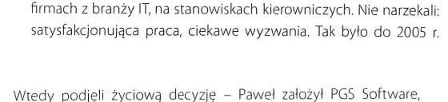
Polish (15)

Slide 25

NN Learner (Translated) English (35)

Slide 26
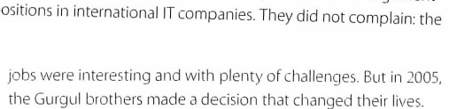
Native English (26)

Slide 27
N Eng: They did not complain: the jobs were interesting and with plenty of challenges. But in 2005, the Gurgul brothers made a decision that changed their lives. 26 words
Learner Eng: It was a gratyfying job for them with interesting challenges so they have never complained about it, at least not till 2005. It was the time, when they decided to make a huge life choice. 35 words

Slide 28
Preliminay results:
Verbosity in NNS texts
Similar to the collected TAPP data:
Typological difference: more words in English than in Polish (but shorter words in Eng)
Pol. 59 > Eng. 87 per paragraph
Significantly more words in student English (NNE) than in Native English (NE)
NNE 87 – NE 79 per paragraph
verbosity, avoidance of phrasal verbs, more descriptive expressions

Slide 29
Preliminary results:
Translation/Writing in(to) Native Language
The students’ weak native metalinguistic competence – US and PL students
English language interference on the native language (PL) is particularly strong in their use of inadequate (clumsy) syntax
Inadequate genre and style
LSP (Eng and PL terminology) – inadequate; errors of avoidance

Slide 30
Preliminary results:
Problem areas in Learner English
Comprehension:
terminology, abbreviations,
idiomatic/conventional phraseology, informal/colloquial language
Production:
articles
word order
incorrect terminology
awkward style (long, clumsy sentences)
inappropriate collocations
inconsistent register

Slide 31
Corrective feedback

Slide 32
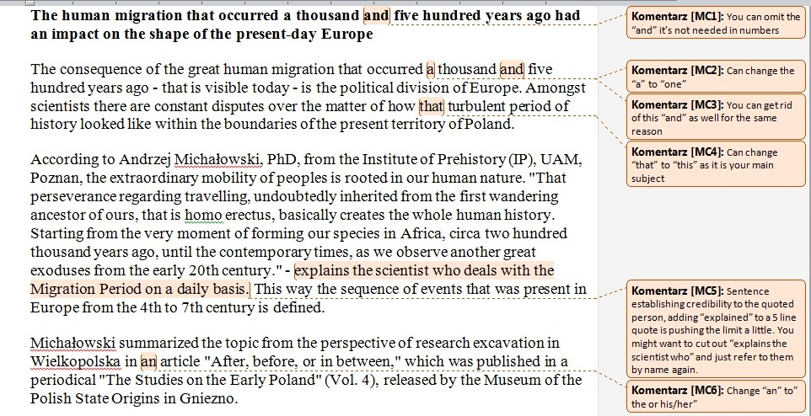

Slide 33
Highest frequencies of feedback:
Clarification requests
Response of a more competent student (typically L1 but not always) to an ill-formed/vague language
[corrective feedback]
Response of a less competent student (typically L2 but not always) to a vague concept / unfamiliar term / culture-spectific form/complex syntax
[interrogative feedback] can lead to [corrective feedback]

Slide 34
*Language/terminology corrective feedback

Slide 35
Law-related terms
QUESTIONS: NNS > NS
5) when you write "legislation [...] need to approve the transfer" you mean that there should be some new regulations introduced in the Dakota, Minnesota and Canada's legislation or that those two states and Canada should sign a kind of tripatriate agreement or pact?

Slide 36
6. By "legislature" (p. 4. l. 13) that operates on a biennum [biennium] you mean the group of people that decide about rules and regulations, am I right? That they're elected every two years?

Slide 37
QUESTIONS
Just a few questions more:
1) sustainable source (p. 1, l. 7) - do you mean that this source is stable/balanced/reliable or rather renewable?
2) About the appropriation issue - I understand that appropriation is giving permission to use the water, but does it involve constructing a new installation, I mean like some pipes to supply water from the main/municipal pipeline to the building/allotment?
2) senior users – are they old users?

Slide 38
NS ANSWERS
1) I'm referring to the natural source (the Red River). That sentence wasn’t very clear. Sorry.
2) Appropriation means the state government is granting permission to use natural resources.
3) Senior users are communities and individuals who have been taking water from a source for the longest time. This is an important factor because it determines how fairly we can divide the water resources. When you can regulate how much upstream users are going to use, you know how much water is left over for communities downstream. Our system at the moment is just "first come, first serve", regardless of the impact to others.

Slide 39
Monitor corpus
5 | The House and Senate appropriations committees heard proposals Wednesday , Jan . 4 , for a new legislative forecast for the coming two-year budget cycle that includes nearly $ 1.9 billion less in general fund revenues than what 's projected for the 2015-17 | biennium | , which ends June 30 . | westfargopioneer.com | 4/1/2017

Slide 40
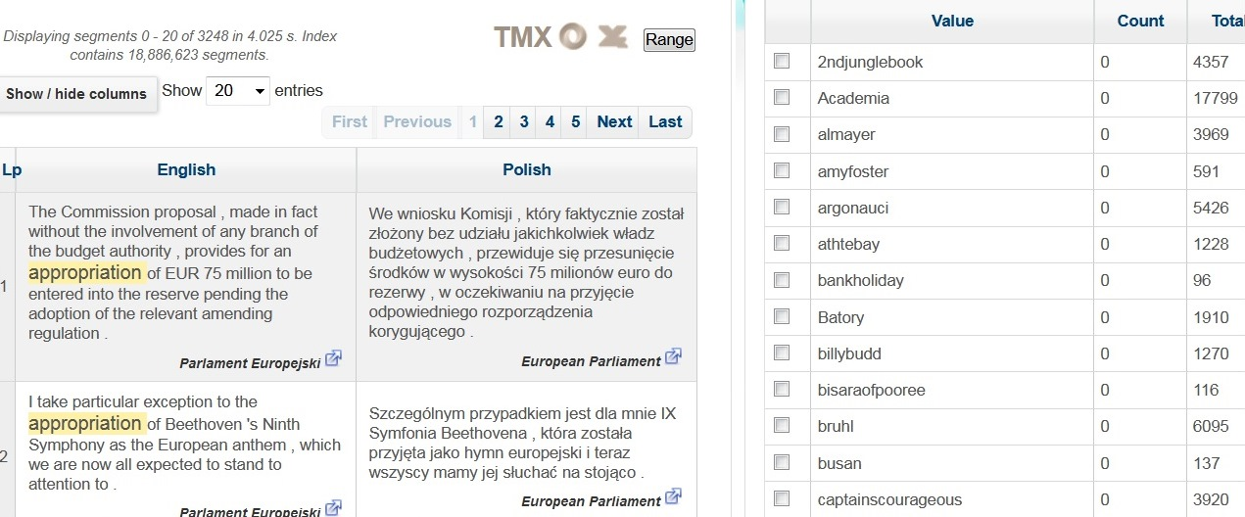

Slide 41
legislation/prawodawstwo
Parallel corpora
Sources: Acquis communautaire, Community Research and Development Information Service, Cordis Focus Newsletter, The European Union budget at a glance, Inforegio news

Slide 42
Eng>Pol clustering legislation
Legislation (1187 segments)
prawodawstwo
przepisy
prawo/a
produkty (prawne)
siła wnioskodawcza
legislacja
ustawodawstwo/a

Slide 43
Parallel corpus concordances
(Eng) The current legislation on FP6
(Pol) Obecne prawodawstwo dotyczące 6. Programu Ramowego
In both languages the corresponding forms legislation/prawodawstwo can be used as plural nouns, although in English the relevant term corresponds to a number of (more clearly countable) plural nouns (e.g., laws in such cases:
(Eng) Approximation of the laws of Member States Pol. (Pol) Zbliżenie ustawodawstw Państw Członkowskich

Slide 44
legislation/przepisy clusters
(Eng) Communication from the Commission concerning the fraud-proofing of legislation and contract management
(Pol) Komunikat Komisji odnośnie odporności na oszustwa przepisów [regulations] oraz zarządzania umowami
(Eng) the decision to withdraw from the joint declaration would not affect national legislation
(Pol) decyzja o wycofaniu się ze wspólnej deklaracji nie będzie miała wpływu na prawo [law] krajowe

Slide 45
Adjectival collocates of Eng. law
# | Collocate | POS | A | TTEST | MI3
1 | common | AJ% | 1143.0 | 30.36307 | 23.61193
2 | criminal | AJ% | 659.0 | 24.58117 | 23.28624
3 | international | AJ% | 467.0 | 15.03855 | 19.45194
4 | english | AJ% | 381.0 | 14.64369 | 19.14856
5 | poor | AJ% | 360.0 | 14.02053 | 18.92129
6 | martial | AJ% | 197.0 | 13.80898 | 21.19636
7 | civil | AJ% | 198.0 | 10.18147 | 17.1137
8 | electoral | AJ% | 119.0 | 9.6397 | 16.89334
9 | bonar | AJ% | 86.0 | 9.21099 | 20.06259
10 | constitutional | AJ% | 85.0 | 7.14333 | 14.96952
11 | roman | AJ% | 96.0 | 6.94653 | 14.95072
12 | public | AJ% | 296.0 | 6.62115 | 17.11989
13 | administrative | AJ% | 83.0 | 6.62045 | 14.62146
14 | islamic | AJ% | 54.0 | 6.21466 | 14.20604
15 | natural | AJ% | 164.0 | 5.76453 | 15.57795

Slide 46
Verbal collocates of Eng. law
# | Collocate | POS | A | TTEST | MI3
1 | break | V% | 332.0 | 15.72048 | 19.61545
2 | pass | V% | 221.0 | 11.56351 | 17.74617
3 | enforce | V% | 141.0 | 11.44224 | 19.05944
4 | require | V% | 244.0 | 11.06555 | 17.63941
5 | relate | V% | 169.0 | 10.43464 | 17.14304
6 | govern | V% | 108.0 | 9.79405 | 17.62839
7 | obey | V% | 92.0 | 9.25005 | 17.85848
8 | apply | V% | 147.0 | 8.12541 | 15.99956
9 | change | V% | 171.0 | 7.96004 | 16.18943
10 | impose | V% | 86.0 | 7.57482 | 15.30115
11 | protect | V% | 90.0 | 7.21933 | 15.04853
12 | prohibit | V% | 55.0 | 7.06636 | 15.96862
13 | violate | V% | 47.0 | 6.61134 | 15.91966
14 | forbid | V% | 46.0 | 6.30183 | 14.86629
15 | err | V% | 37.0 | 5.97852 | 16.28558
16 | allow | V% | 156.0 | 5.70783 | 15.45176
17 | state | V% | 75.0 | 5.69909 | 14.00588
18 | regulate | V% | 40.0 | 5.63951 | 13.85055
19 | flout | V% | 31.0 | 5.47293 | 15.78399
20 | enact | V% | 33.0 | 5.41605 | 14.21698

Slide 47
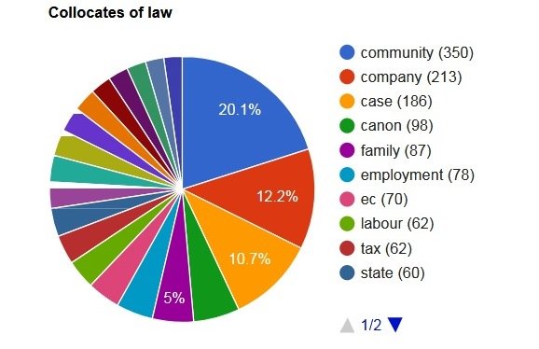
Noun collocates

Slide 48
Consult terminological thesaurus:
Sus law (16th on the collocate list)
In England and Wales, the sus law (from "suspected person") was the informal name for a stop and search law that permitted a police officer to stop, search and potentially arrest people on suspicion of them being in breach of section 4 of the Vagrancy Act 1824.
The Vagrancy Act 1824 (5 Geo. 4. c. 83) is an Act of Parliament of the United Kingdom that makes it an offence to sleep rough or beg.

Slide 49
Cluster equivalence
Pol. motor
Conventional: Pol. motor/motocykl – Eng. motor/motocycle)
Extended - units of the closely related neighbouring clusters Pol. motor – Eng. bicycle/moped
Emergent - novel, creative, often figurative, of a lower frequency and incidence. Eng. fast flying raptor - raptor (orig. animal dromeosaurus) – Lockheed F-22 Raptor – Raptor – rocket engine)

Slide 50
Preliminary results:
Problems: Keywords – Thresholds - Terms
e.g. energy, legislature
A threshold concept is distinguished from what might be termed a ‘key’ or ‘core’ concept as it is more than just a building block towards understanding within a discipline.
Meyer and Land (2006b, p. 3) describe the threshold concept as
”akin to a portal, opening up a new and previously inaccessible way of thinking about something. It represents a transformed way of understanding, or interpreting, or viewing something without which the learner cannot progress”
Terminological problem areas

Slide 51
Threshold concepts are often selected accidently, as they are connected with keywords of some teaching matters
Specialist authors test a method of disciplinary inquiry,
  using analysis of given circumstances,
  collecting data through multiple methods,
  and analyzing results in a systematic approach, which includes interviews, case studies (Land, 2006; Davies, 2005)

Slide 52
The notion of a threshold concept may act as
”a catalyst, drawing together a variety of fields of research in a productive educative framework”
Collaborative research framework
productive re-viewing of lecturers’ expectations, student’s use of terms, the curriculum and textbooks within disciplines

Slide 53
US students’ opinion on Polish feedback
PL Ss offered very good suggestions toward helping the US students to be more clear and articulate in their writing
US Ss learn that they need to cooperate with people rooted in different cultures and linguistic systems.
When writing, US Ss learn to develop more consideration towards people from other cultures and their expectations.

Slide 54
PL Ss opinion on US feedback
The US students provided wider exposure to more varied style and register to NNSs - US students are terminology experts in their fields

Slide 55
Conclusions
Exposure to
LSP via collaboration with NSs, specializing in the fields
Via collaboration with business partners (producers, logistics, newspaper agencies, museums)
The programme covers intercultural communication, media discourse, social psychology
ESP competence devlopment

Slide 56
The role of media – institutional production, text, audience
Speaking and writing for public audiences
Divergent reception [viz. Cluster equivalents]

Slide 57
Lewandowska-Tomaszczyk, B. 2017. Cluster Equivalence, General Language, and Language
for Specific Purposes. In: M. Grygiel (ed.) Cognitive Approaches to Specialist Language. Newcastle upon Tyne: CSP 384 – 418.
Lewandowska-Tomaszczyk & L. Bogucki 2016. Volunteer translation, collaborative
knowledge acquisition and what is likely to follow. In: Ł. Bogucki, B. Lewandowska-Tomaszczyk, M. Thelen (red.) Translation and Meaning. New Series. Vol. 2, Pt 2. Frankfurt a. Main: Peter Lang. 37-46.
Lewandowska-Tomaszczyk, B. & H. Slomski 2016 Collaboration in language development
between American and Polish university students. Konin Language Studies (3). 305-330.
Maylath, B., Vandepitte, S., Minacori, P., Isohella, S., Mousten, B., & J. Humbley. 2013.
Managing complexity: A technical communication translation case study in multilateral international collaboration. Technical Communication Quarterly, 22: 67–84.
Pęzik P.2016. Exploring phraseological equivalence with paralela. In: Gruszczyńska, E.&
A.Leńko-Szymańska (eds.) Polish-Language Parallel Corpora. Warsaw. 67-81.

Slide 58
Select bibliography Part 1: Translation
Babych, B. , A. Hartley, K. Kageura, M. Thomas, M. Utiyama (2012). MNH-TT: a collaborative platform for translator training . Translating and the Computer 34. 2012, London, UK .
Bachmann-Medick, D.(ed)2009. Translation Studies, Special Issue. Vol. 2, Nr. 1, Routledge, London.
Baumbusch, J. Sh. Reimer Kirkham, K. Basu Khan, H. McDonald, P. Semeniuk, E. Tan, J. M. Anderson (2008). Pursuing Common Agendas: A Collaborative Model for Knowledge Translation between Research and Practice in Clinical Settings. Research in Nursing & Health, 31, 130–140.
Bogucki, L. Amateur Subtitling – Is There a Future for Home-made Captions? In: Anderman, G. and J. Diaz-Cintas (ed.), 2009, Audiovisual Translation. Language Transfer on Screen, Palgrave Macmillan.

Slide 59
Castells, M. (2009). Communication Power. New
    York: Oxford University Press.
Cooper, C. (2011). Is Translating Crowdsourcing Unethical? Localisation, Security and Project Management. http://colincooper.net/?p=31
Künzli, A. and M. Ehrensberger-Dow (2011). ‘Innovative subtitling. A reception study.’ In: Alvstad, C., Hild, A. and E. Tiselius (eds.) Methods and Strategies of Process Research. Integrative Approaches in Translation Studies. Amsterdam/Philadelphia: John Benjamins, 187-200.
Lewandowska-Tomaszczyk, B. (2010). ”Re-conceptualization and the emergence of discourse meaning as a theory of translation”. In: Lewandowska-Tomaszczyk, B. and M. Thelen (eds.) Meaning in Translation. Frankfurt a. Main: Peter Lang. 105-148.

Slide 60
Lewandowska-Tomaszczyk, B. (2012). "Explicit and tacit - An interplay of the qualitative and quantitative approaches to translation" In: M.Oakes and Meng Ji (eds).Quantitative Methods in Corpus-Based Translation Studies. Amsterdam: Benjamins. 3-33.
Lewandowska-Tomaszczyk, B. (2015). Przekład kolaboratywny: nowy model procesu tłumaczenia i edukacji translatorskiej. Piotrków: UJK, Nowe Konteksty Edukacyjne.
Lewandowska-Tomaszczyk, B. and L. Bogucki (in press).
Munro, R. (2010). Crowdsourced Translation for Emergency Response in Haiti: the Global Collaboration of Local Knowledge. AMTA Workshop on Collaborative Crowdsourcing for Translation. Denver, Colorado.

Slide 61
O’Hagan, M. (2008). Fan Translation Networks: An Accidental Translator Training Environment? In Kearns, J. (ed.) Translator and Interpreter Training: Methods and Debates. London: Continuum, 158-183.
O’Hagan, M. (2009). Evolution of User-generated Translation: Fansubs, Translation Hacking and Crowdsourcing. Journal of Internationalisation and Localisation 1, 94-121.
O’Hagan, M. & Ashworth, D. (2002). Translation-Mediated Communication in a Digital World: Facing the Challenges of Globalization and Localization. Clevedon: Multilingual Matters.
Ray, R. (2009) Crowdsourcing: Crowd wants to help you reach new markets, Romainmôtier: Localization Industry Standards Association.

Slide 62
Pym, A. (2003). Localization and the Dehumanization of Discourse. The Linguist 41(6), 168-170.
Pym, A. (2004). The Moving Text: Localization, Translation and Distribution. Amsterdam: John Benjamins.
Pym, A. (2007). Translation Technology as Rupture in the Philosophy of Dialogue. In Kemble, I. (ed.).Translation Technologies and Culture. Portsmouth: University of Portsmouth, 1-9.
Pym, A. (2011). Democratizing Translation Technologies: the Role of Humanistic Research. Paper presented to the Luspio Translation Automation Conference, Rome. Retrieved from: http://usuaris.tinet.cat/apym/online/ research_methods/2011_rome.pdf.

Slide 63
Part 2: SLA
Arnold, N. and L. Ducate (2006).Future Foreign Language Teachers' Social and Cognitive Collaboration in an Online Environment Language Learning & Technology 4
Kruse, O. (Bereich Lehre - Arbeitsstelle für Hochschuldidaktik der Universität Zürich Dossier Wissenschaftliches Schreiben und studentisches Lernen, 2012, p. 10)
Delcambre, I., & Boch, F. (2006). Les écrits à l’université: Inventaires, pratiques,
modeles. Proposal to the Association Nationale de Recherches, France
Donahue, T., (2009). Genre and Disciplinary Work in French Didactics Research pp.440-441

Slide 64
Long, M. H. (1996). The role of the linguistic environment in second language acquisition. In W. C. Ritchie & T.
K. Bhatia (Eds.), Handbook of second language acquisition (413-468). San Diego, CA: Academic Press.
Maylath, B. (1997). Writing globally: Teaching the technical writing student to prepare documents for translation. Journal of Business and Technical Communication, 11, 339-52.
Nicol, D. J. & Milligan, C. (2006) Rethinking technology- supported assessment in terms of the seven principles of good feedback practice. In: Bryan,C. and Clegg, K. (eds) Innovative Assessment in Higher Education. London: Taylor and Francis Group Ltd.
Schmidt, R. (1995). Consciousness and FL learning. Honolulu, Hawai’i: University of Hawai’i

