Slide 1
Enriching ELT with ESP:
An Indian Perspective
Sabitha Joseph
Assistant Professor
The Cochin College
India

Slide 2
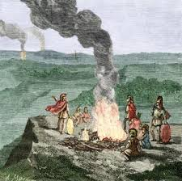
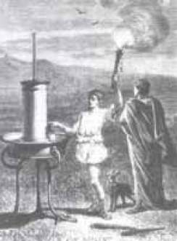
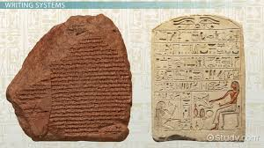
Communication
The act of transfer of information
The History
Natural codes-sun position, stars,wind,rain
By showing signals- Fire lantern, clap, howl, smile,cry etc
Marking symbols – on trees, rocks, land etc
Speech- Language

Slide 3



Interaction between countries
English – The Global Language
Continuous Expansion
Socialization

Slide 4
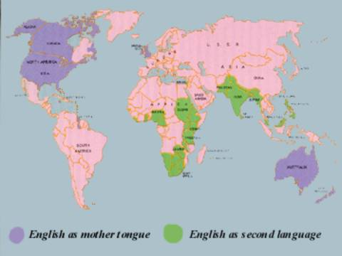
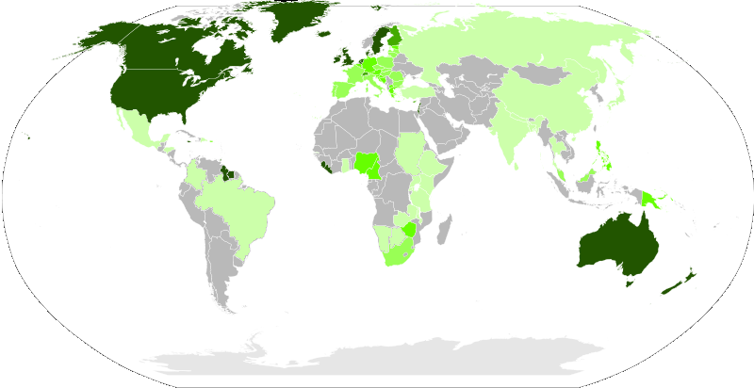
Two major categories of people using English can be identified

Slide 5


A matter of Pride
The people who consider English as their mother tongue regard it as a matter of pride on the spreading of their language but they are anxious about the way in which others use it.

Slide 6
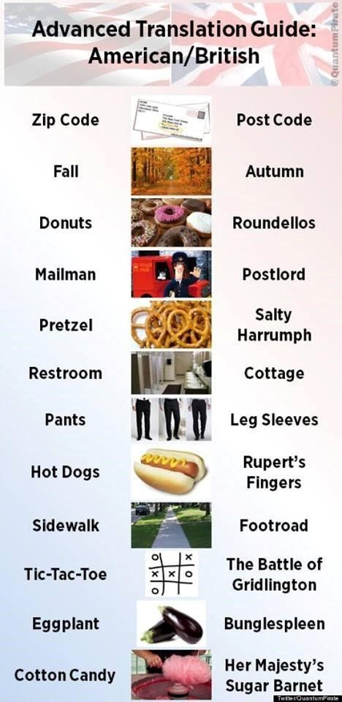
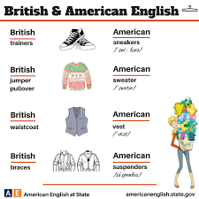
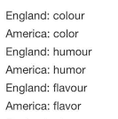
British Vs American
        “Look what the Americans have done to English” is not an uncommon comment found in the letter-columns of the British press” (Crystal, 2003, p. 3).

Slide 7
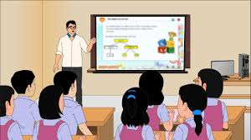
ELT

Slide 8
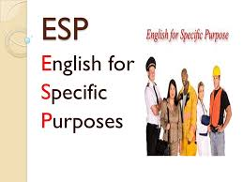

English for Specific Purpose

Slide 9
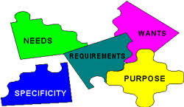
The History of ESP
ESP is the result of the effort of people all over the world who wanted to learn English because of its important role in the fields of science , technology and commerce.( Hutchinson T. & Waters. A, 1987)

Slide 10

ESP in India
ESP emerged as a special branch of ELT in the western world, only during the second half of twentieth century, but it appeared in India, as special purpose language, centuries back (Chaudhary, 2002).
In India English emerged mainly as a language for trade and administration during the British period and from then onward English for employment was one of the main objectives of English learning in colonial India (Tasildar, 2013).

Slide 11
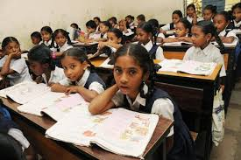
ESP and Indian Education
Though ELT is handled well in the curricula of schools and universities in India, the extent to which ESP is dealt seriously in the curricula is to be examined.
The present Indian education system provides very less emphasis to ESP. Though many end up satisfied with high profile jobs it is noticeable that they lack language competence.

Slide 12
Present Work
Sub types of ESP in connection with two selected category of people in India viz. Kochi-Mattancherry area dealing with international tourists and traders and the other in Kochi- IT and science regime.
These findings are equally applicable to similar regimes.

Slide 13
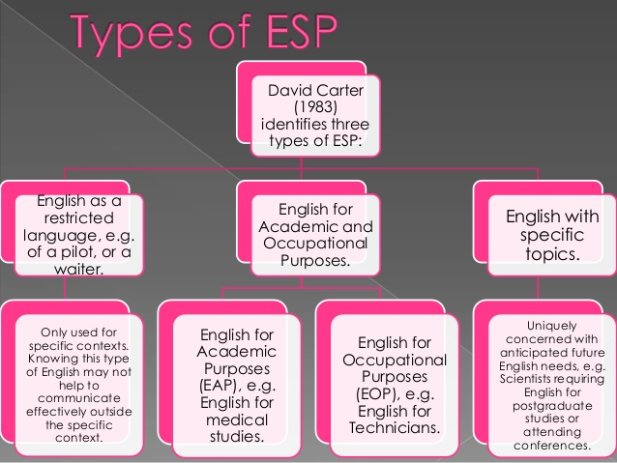
ESP Variants
ESP variants like English for occupational purpose, English for communication, English for science and technology, English for trade, English for hospitality Industry and the like.

Slide 14

English for Hospitality Industry
The hospitality industry consists of utility sector like lodging, restaurant and entertainment areas such as dance floors, bars, clubs
Tourists interact with the local traders. This opens a very high opportunity to the local trades’ men to use English language.

Slide 15
In the broad sense, where tourism is concerned, a city itself is a part of hospitality industry.
The moment a tourist enters our city, one who directly or indirectly interacting with them becomes a part of this industry.

Slide 16
Hospitality sector extends to resorts or home stays where the tourists lodge.
A city as a large hotel and people living in it can be considered as employees .
Empower people of the city with skills required to deal with international tourists.
Increases the revenue of the country
A good cultural exchange between the two.

Slide 17
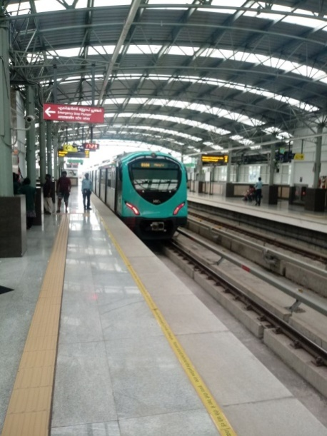
Kochi- Mattancherry
A survey was conducted among various categories of people in Kochi area, from auto/taxi drivers to tea shop vendors, from police men to restaurant suppliers, from street shop personal to cruise organizers
To know how they need English for the specific purpose to progress in their professional chart.

Slide 18
English for Hospitality Industry
1. How good are you in communicating in English?
Poor b) Fair c) Excellent
2. Are you confident of speaking in English?
a)Not at all confident b) Confident c)Totally confident
3. Are you able to understand what the speaker conveys?
a) Slightly b) Moderately c) Completely
4. Are you able to read and understand if a write up in English is provided to you?
a) Slightly b) Moderately c) Totally
5. Are you able to give proper directions in English to guide the tourists?
a) Never b) Sometimes c) Always
6. Do you know to draft a letter in English?
a) No b) Quite a bit c) Yes
7.Which skill do you feel is most useful in day to day life?
Listening b) Speaking c) Reading d) Writing
8.Why didn’t you learn English?
a) Couldn’t get an opportunity b) Not interested c) Lack of need based courses
9.Does the lack of fluent language adversely affect business?
a) No b) To a certain extent c) Yes
10. Do you feel there is a need to get trained in ESP?
a) Disagree b) Agree c)Strongly agree

Slide 19
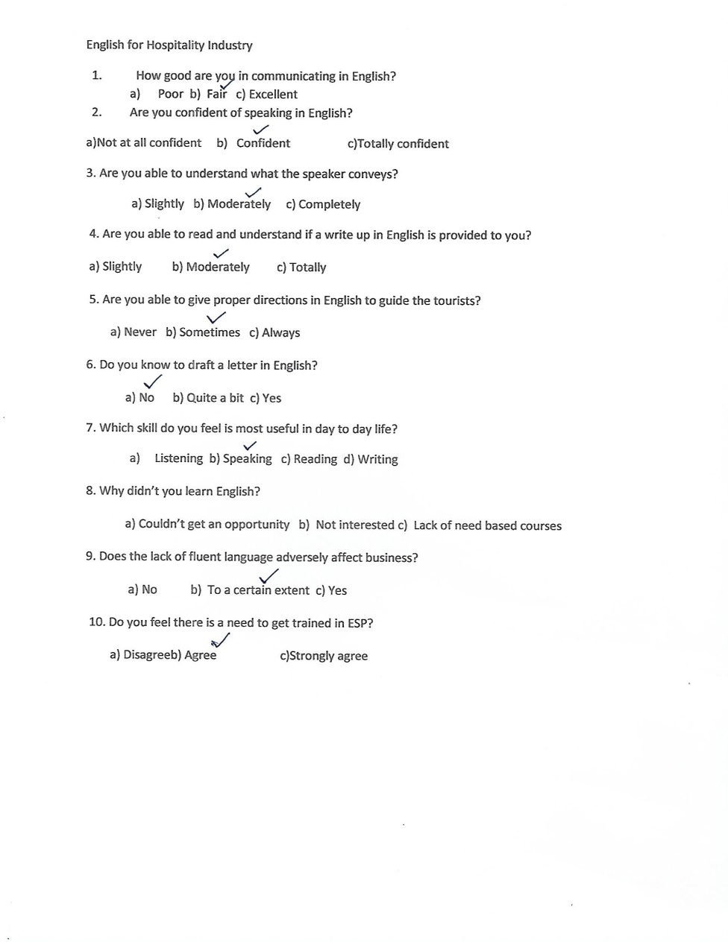

Slide 20
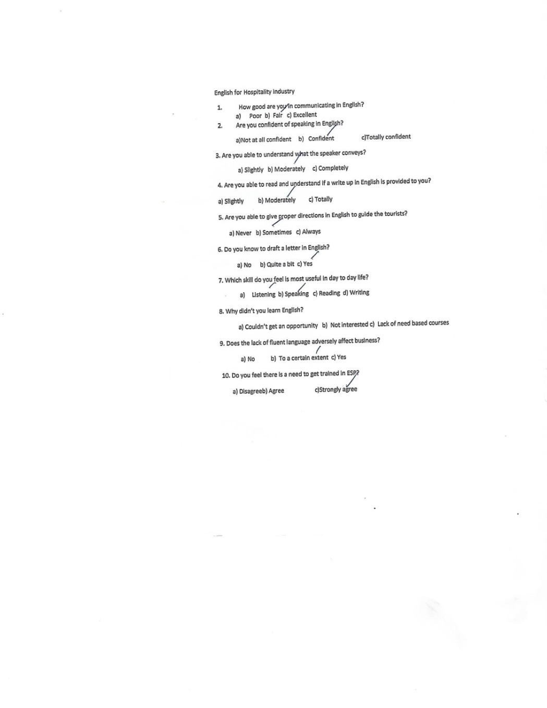
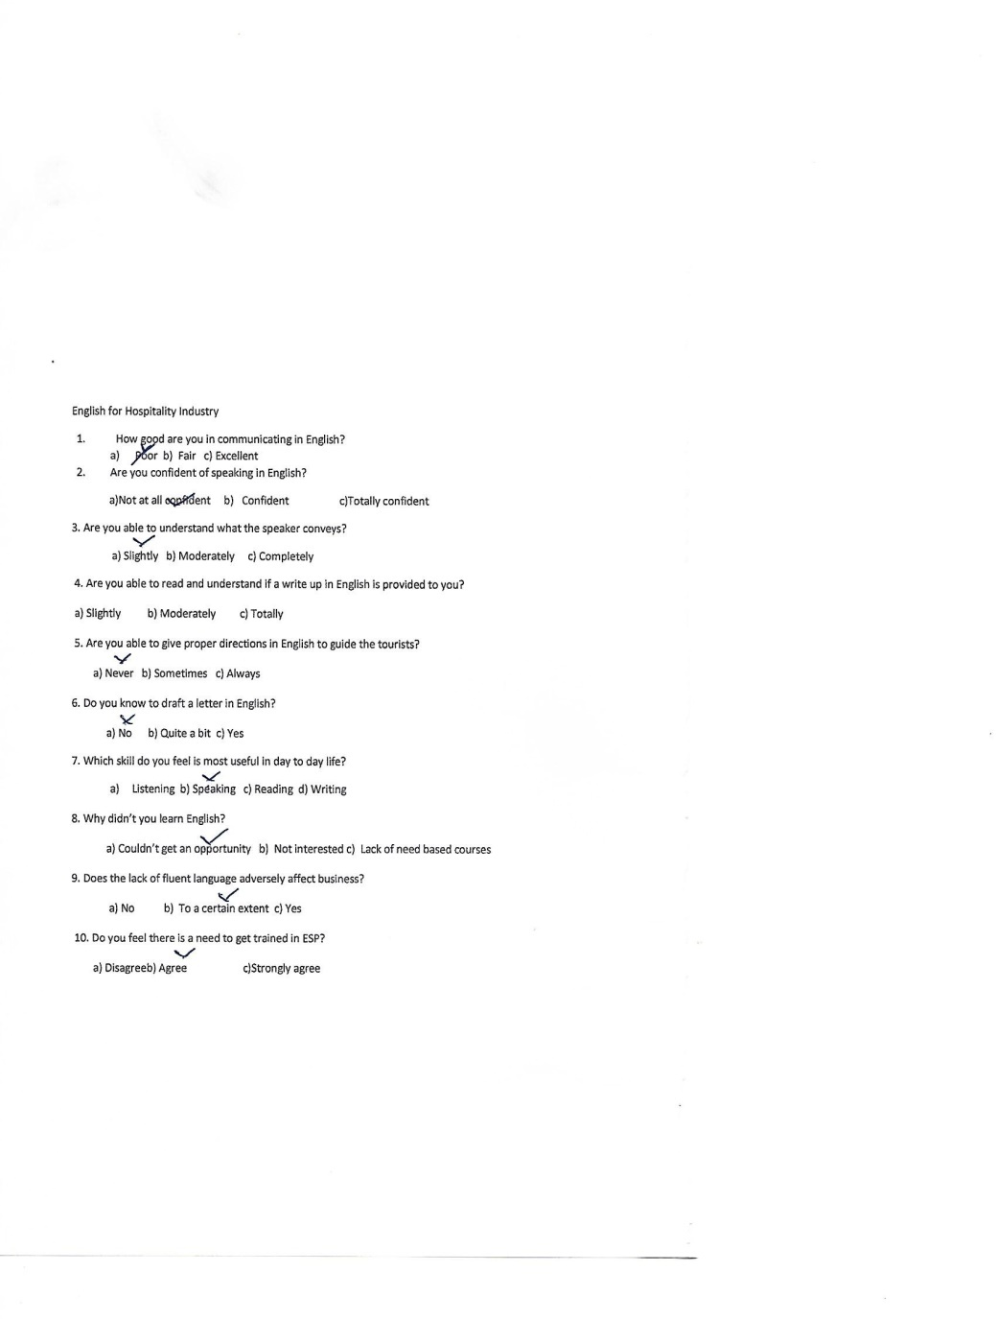

Slide 21
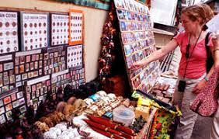
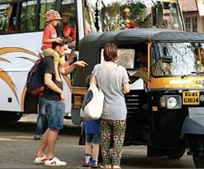
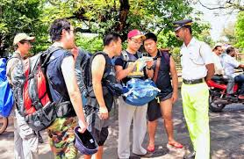
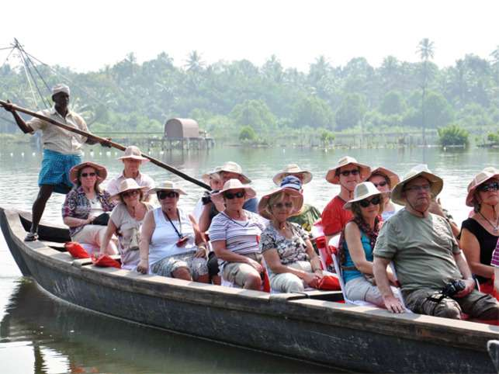
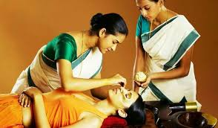
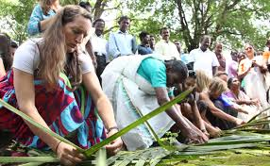
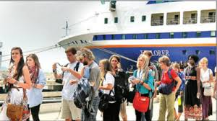
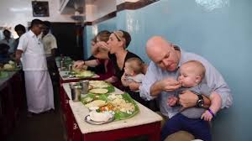
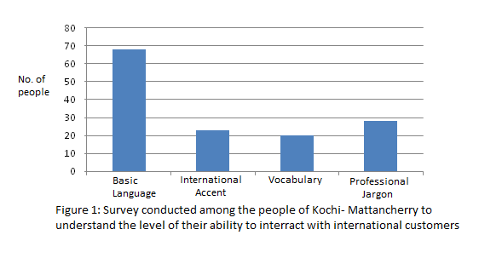
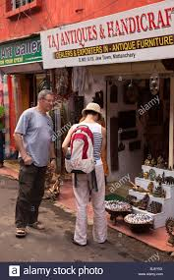

Slide 22
A class of well educated people communicating fluently to the international tourists has the better chance of attracting them.
The survey showed that, if they get training in English for specific purpose from the school age it would benefit them personally and in turn benefitting the society.
So the schools and colleges of this area should be encouraged to add ESP as an additional attachment/subject to the curriculum.

Slide 23
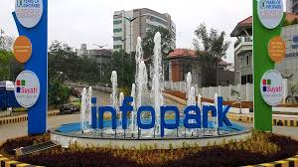
English for IT industry
IT industry is a global business. So most of them in this field have to deal with international clients or they have to work for their international parent organization.

Slide 24

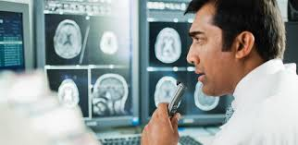
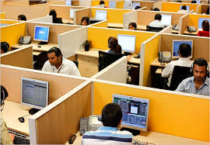


Online tutoring
Software development team
Medical transcription
Other BPO companies.

Slide 25
English for IT sector
1.How often do you use English at your workplace?
a)Very rarely b)occasionally c) very often
2.Do you speak in English to your colleagues and friends?
a) Never b) very often c) Always
3. Have you interacted with a native English speaker?
a) Never b) Sometimes c) Very often
4. Do you think grammar is essential for effective communication?
a)No b) Quite a bit c) Yes
5.How did you become fluent in the language?
a) ESP practical tutoring b) Self training c) Theoretical Knowledge
6. How far did the academic syllabus help you in achieving competency in the language?
Slightly b) Moderately c) To a great extent
7.What did you feel was lacking in the syllabus?
a) Practical ESP tutoring b) Theoretical knowledge c) Assignments/Exercises
8. Do you feel the curricula needs to incorporate ESP and make it a part of academic discipline ?
a)Disagree b)Agree c) Strongly Agree
9.What do you think as apt for learning English ?
a) Real life experiences b) Lectures /theory classes c) Practical sessions
10. Do ESP uplifts a person’s business profile and his self esteem?
a) Disagree b) Agree c)Strongly Agree

Slide 26
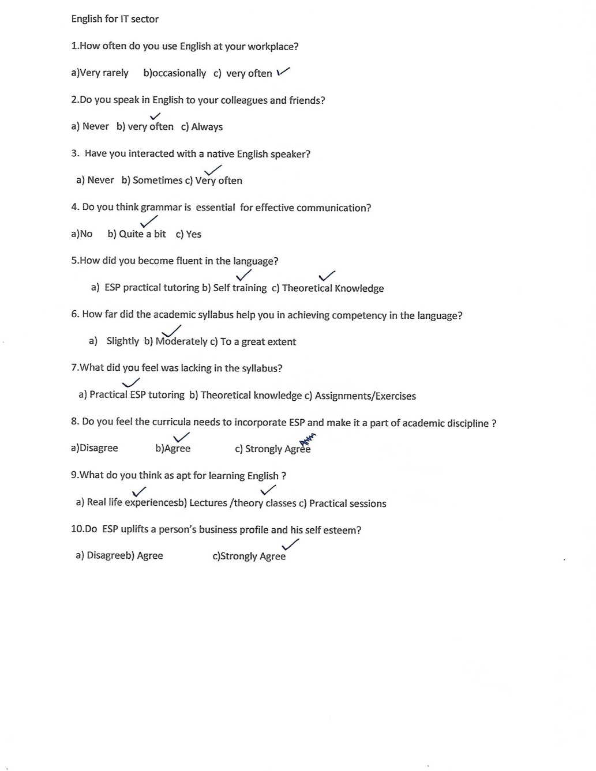
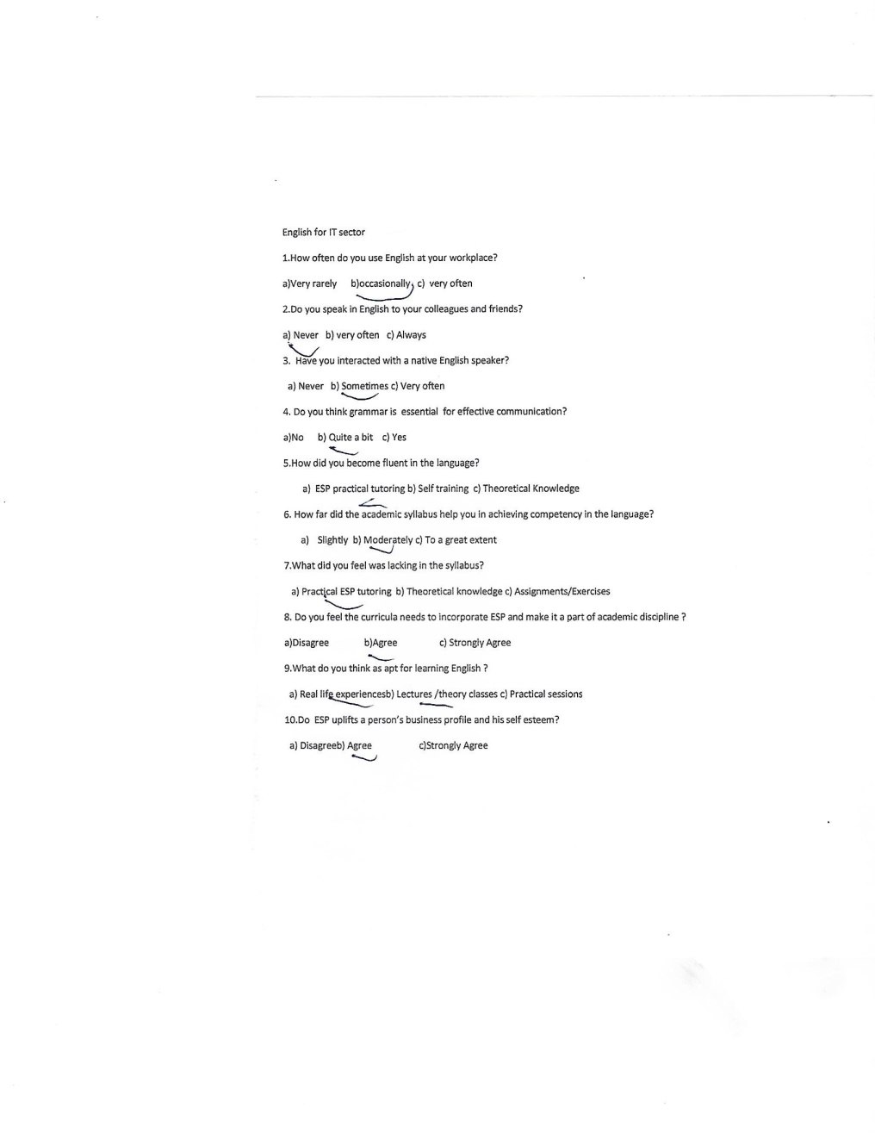

Slide 27
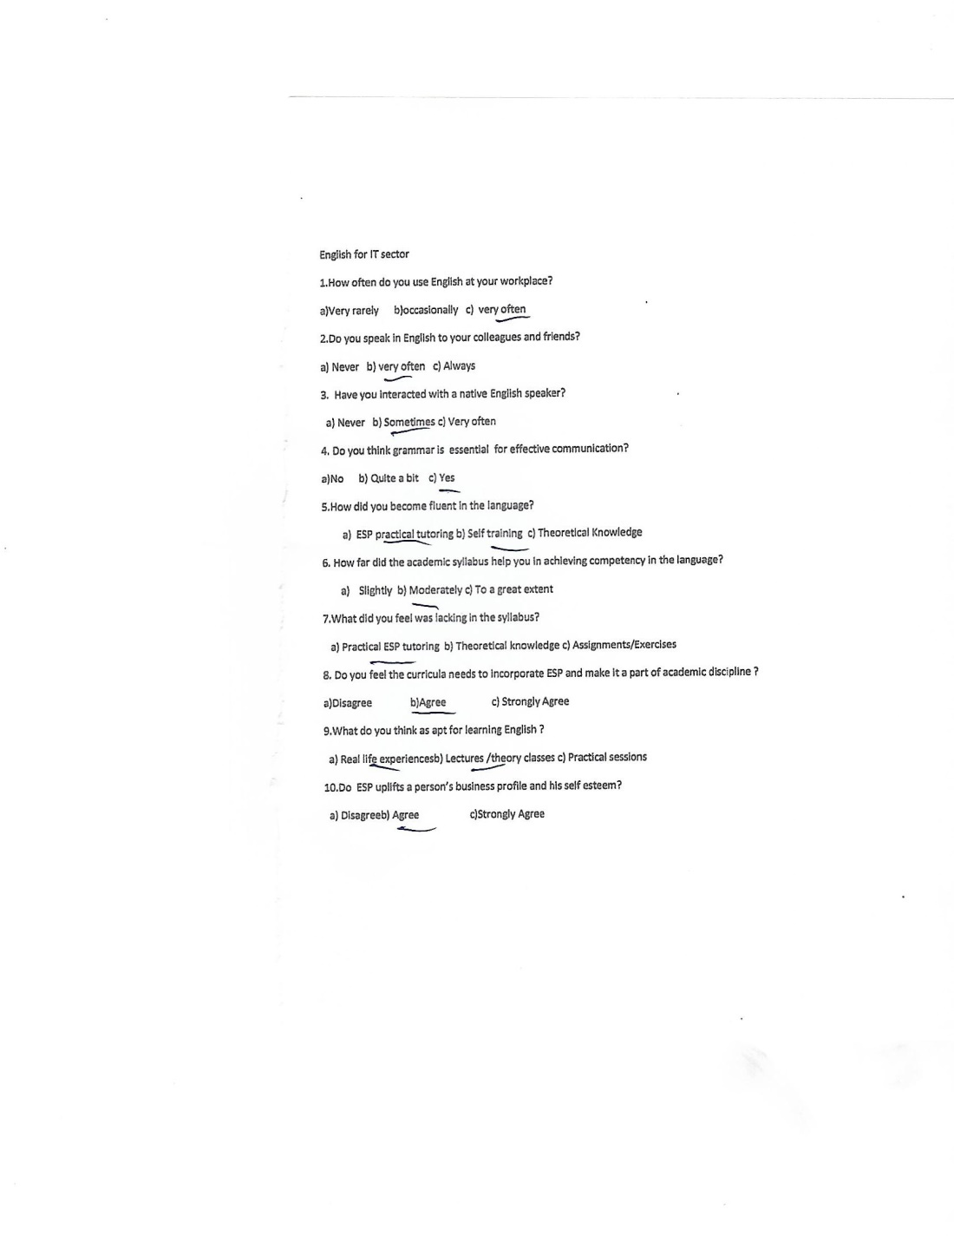

Slide 28
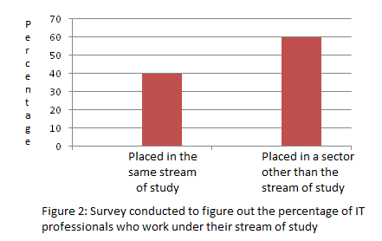
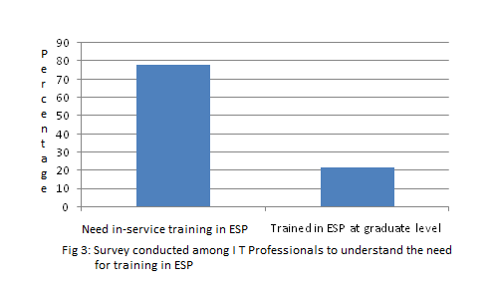
The results of a study conducted among 500 people from various IT organizations in Kochi are shown below.

Slide 29
Shows the percentage of man power intake in to various jobs
A major portion of the educated manpower is employed in different profession than they were trained in.
Another category work in IT companies whose clients are from different countries like U.K, U.S.A and other English speaking countries.

Slide 30
Revealed the necessity of implementing ESP in IT industry
The status and designation to which these people are assigned varies from their field of specialization.
Organize ESP classes to their employees at the entry level.
Refresher sessions in ESP among their employees on a regular basis directly or through online mode.

Slide 31
Conclusion
Hospitality Sector
people need to be trained from graduate level or even before as they have to interact with international tourists.
So schools and colleges of that area must be advised to insert ESP along with their recognized curriculum.
Information Technology Best to bring in a kind of in- service training in ESP after the candidates have been appointed to the specified posts. Along with a regular refresher session in ESP to keep them updated

Slide 32
Whatever be the time and place to implement ESP to these categories, it’s a proven fact that they need support to learn English for their requirements
This throws a clear idea about the implementation of need based learning, equipping them with ESP to make people pioneers in their particular stream.

Slide 33

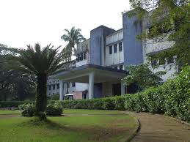
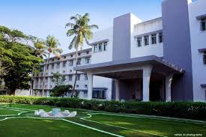
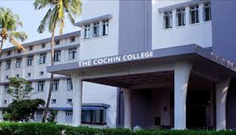
Thank You
Sabitha Joseph
Assistant Professor
Department of English
The Cochin College
Kochi, Kerala, India
sabithajoseph14@gmail.com

