Slide 1
Authorial Identity in L1 and L2 Writing in Sociology
Dr. Eda Işık Taş
Middle East Technical University
Northern Cyprus Campus

Slide 2
Language Socialization
Language socialization is a process through which novices or newcomers to a community acquire the “knowledge, orientations, and practices” that will help them gain “membership and legitimacy” (Duff, 2007) in that group.
Notes:
First of all, I would like to start with an operational definition of language socialization by Garret and Lopez and Duff.

Slide 3
Academic Discourse Socialization
(Duff, 2007)
being competent in language use
Adopting appropriate identities associated with the target disciplinary discourse communities

Slide 4
Language use
Appropriate identity

Slide 5
Academic evaluation systems
favor publications in international journals
encourage scholars to write in English for international academic communities

Slide 6
Non-Anglophone scholars have difficulty in meeting the discoursal norms of mainstream international publications

Slide 7
Academic publication in Turkey
Prosperous center: “endowed with ample resources and characterized by a rigorous meritocratic culture” (Bennett, 2014)
Disadvantaged periphery: “deprived of such resources and culture” (Canagarajah, 1996, 2002).
Semiperiphery: “a fuzzy area that mediates between the two poles” (Dontcheva-Navratilova, 2014)”.

Slide 8
A good example of a semiperipheral culture is Turkish academia
currently in transition
moving rapidly towards the center in terms of state policy
while still preserving more peripheral characteristics at the institutional and personal levels

Slide 9
Internationally-Oriented
Turkish Scholars
Locally-Oriented
Turkish Scholars

Slide 10
Aim of the study
To explore the role of publication context–mainstream international English and Turkish national–in shaping Turkish scholars’ “authorial identity” in RAs in the field of Sociology.

Slide 11
Construction of authorial identity
Academic writers use various linguistic strategies to interact with their readers and to construct their authorial identity (Ivanič, 1998).

Slide 12
Three aspects of identity interacting in writing
(Ivanic, 1998)
autobiographical self
inﬂuenced by writer’s life-history
discoursal self image or ‘voice’ the writer projects in a text
authorial self manifested in the extent to which a writer claims responsibility for the text
Notes:
So, academic disxousre socialization includes not only adoption of linguistic conventions but also practices and identities associated with that community. First I used “discoursal self” to mean both author

Slide 13
Interactional | Involve the reader in the argument | Resources
Hedges | withhold writers full commitment to proposition | might / perhaps / possible / about
Boosters | emphasize force or writer's certainty in proposition | in fact / definitely / it is clear that
Attitude markers | express writer's attitude to pro-position | unfortunately / I agree / surprisingly
Engagement markers | explicitly refer to or build relationship with reader | consider / note that / you can see that
Self mentions (First person pronouns) | explicit reference to author(s) | I/me//my/we/us/our/
(Hyland, 2002)

Slide 14
Tang and John’s (1999) typology of possible identities behind the first person pronoun
3- I as Guide
4- I as architect
5- I as encounter of research process
6- I as opinion holder
7- I as originator
2- I as representative
1- No I
Least powerful
authorial presence
Most powerful
authorial presence
Notes:
For authorial self and Tang and John has developed a continuum to describe the power of presence behind the use of first person pronouns by using methaphors such as guide and architect . These roles re described and examples are given in their article but sometimes it is not sometimes easy to differentiate for example guide from architect or opinion holder from originator. I tried to visually represent the degree of power of each use of I with a color. As the colors become darker and brighter the the strength of authorial presence increases.

Slide 15
Discourse functions of self mentions (Hyland, 2002)
1- Explaining self-benefits
4- stating results/claims
5- Elaborating an argument
2-
Stating a goal purpose
3-stating an opinion
5-Presenting a new idea/knowledge claim
Notes:
Again, I tried to color code them according to power of authorial power or presence orange and red being the most powerful or high risk functions.

Slide 16
My framework for the analysis of discourse functions of first person pronouns
Low-Risk Functions | Medium-Risk Functions | High-Risk Functions
Representing a community | Stating a goal/purpose | Expressing an opinion
Guiding the reader through the text | Explaining a procedure | Elaborating an argument
 |  | Presenting a new idea or knowledge claim
 |  | Stating results/claims

Slide 17
Methodology
Corpus analysis of the frequency and functions of first person pronouns used by three groups of writers:
Turkish writers in Turkish national journals
Turkish writers in international English journals
NSE writers in international English journals
This corpus-based analysis is complemented by interviews that explored Turkish writers’ opinions about the use of first person pronouns in RAs.

Slide 18
Turkish writers in Turkish national journals
Locally-Oriented NNSE writers
50 Writers
who had produced only Turkish RAs in national journals
who were affiliated with Turkish-medium universities in Turkey and had obtained their PhDs from Turkish-medium universities.

Slide 19
Turkish writers in international journals
Internationally-Oriented NNSE writers
30 writers who were
affiliated with English-medium universities in Turkey, in the USA or the UK or in other western countries.
Five of the writers had publications in national journals; the remaining 25 did not.

Slide 20
Low-risk functions
Representing a community
Here, hygiene held a far wider meaning than we would typically give the term today. (NSE 1)
Guiding reader through the text
As we shall now see, this interrelatedness plays a far more prominent role in the second ontological orientation. (Internationally-Oriented 1)

Slide 21
Medium-risk functions
Stating a purpose
I begin by mapping changes in the temporal structures of young people's lives in Australia and then turn to evidence from the LifePatterns study to show how increased variability in these structures is making it more difficult for many to regularly schedule periods of time together with close friends. (NSE 2)

Slide 22
Explaining a procedure
I began by conducting 52 in-depth interviews drawn from a random sample of technical professionals in a single industry. (NSE 3)

Slide 23
High-risk functions
Expressing an opinion
I agree with Conyers that Africa should be the center of, not peripheral to, Africana Studies; however, I might disagree with him regarding the Afro-centric approach, because we may fall into the same trap of Eurocentric Orientalism. (Internationally-Oriented 2)

Slide 24
Elaborating an argument
Before commencing I should perhaps make one point explicit: in my view, if sociology is to develop a more penetrating analysis of the forces that drive individuals to violence it must return to an analysis of subjectivity and once again borrow from cognate fields….What I am trying to do here is to move beyond a meta-psychology of psychopathy and sociopathy. (NSE 4)

Slide 25
Presenting a new idea/knowledge claim
I conceptualize primitive accumulation as …This reconceptualization, I argue, explodes Marx’s formal definition of primitive accumulation as the destruction of various social forms to the effect of establishing a uniform capital-relation between proletarian free labor and capitalist private property. (Internationally-Oriented 3)

Slide 26
Stating results
The evidence I presented belies the importance of Buddhism's faddish and exotic nature -- the Zen boom of the 1950s played a smaller role in Buddhism's rise among politically active poets of the 1960s than is commonly thought, and other equally exotic cultural traditions found fewer followers. (Internationally-Oriented 4)

Slide 27
Findings
There are extensive similarities in the frequency and discourse functions of first person pronouns in English RAs by NSE and Turkish scholars in mainstream international journals.
Turkish writers publishing in national journals tended to avoid using first person pronouns and displaying an overt authorial presence in their RAs.
Conclusion: Publication context is significant in the discoursal choices of academic writers.

Slide 28
Sub-corpus | Total | I | Me | My | We | Us | Our
NSE | 37.2 | 17 | 1.8 | 6.7 | 5.6 | 2.8 | 2.9
Internationally-Oriented NNSE | 39.8 | 21.1 | 0.8 | 2.7 | 8.1 | 2.3 | 2.1
Locally-Oriented NNSE | 6.6 | 0.9 | 0 | 0 | 4.2 | 0.5 | 0.8

Slide 29
Functions | NSE sub-corpus |  |  | Internationally-Oriented NNSE sub-corpus |  |  | Locally-Oriented NNSE sub-corpus
 | Raw | % | SD | Raw | % | SD | Raw | % | SD
Low-Risk | 452 | 30.8 | 21 | 270 | 31.6 | 9.5 | 166 | 84.6 | 4.8
Medium-Risk | 625 | 42.7 | 46.1 | 346 | 40.5 | 12.2 | 25 | 12.7 | 1.9
High-Risk | 386 | 26.3 | 9.3 | 188 | 22 | 6.2 | 5 | 2.5 | 0.4

Slide 30
Use of inclusive “we” by locally-oriented NNSE writers
Informant 3:
Öyle ki bizler, doğrudan sonuçları öngörmek istediğimiz gibi bu arzulanılmayan dolaylı sonuçları da görmek isteriz. (Locally-Oriented 4)
In fact, we want to see these undesired implicit effects, just as we want to foresee the explicit effects.
the desire to keep the readers on your side

Slide 31
Avoidance of “I” by locally-oriented Turkish writers
I think the research that I conducted should be the main focus … The findings for instance should be presented objectively.”

Slide 32
Use of “I” by Internationally-Oriented Turkish writers in high-risk functions
We understand social phenomena through the eyes of the researcher. So, why can’t the researcher say “My interpretation” “My argument”? This is limiting … This [use of first person pronouns] is not only natural, I think it is necessary”.
In light of this discussion, I believe the main contribution of this article is in demonstrating that mortuary practices are highly ignored, but should be considered a critical aspect of studying contemporary migratory networks. (Internationally-Oriented 8)

Slide 33
Use of “I” by Internationally-Oriented Turkish writers in high-risk functions
I say “I argue in this paper” here because I want to make it clear that this argument is mine and it’s new.”

Slide 34
Discussion
Internationally-Oriented Turkish scholars identify themselves with the discourse conventions of international journals rather than national journals.

Slide 35
The differences in how the two groups of Turkish scholars used first person pronouns suggest that within a single NNSE disciplinary discourse community, there might exist multiple discourse communities exerting their influence on different authorial identities in writing.

Slide 36
Implications
To support writers who want to participate at the international level, an ESP genre-based approach to academic writing (see Hyland, 2003; Johns, 2002) can be adopted in graduate level academic writing courses.

Slide 37
Student research in EAP writing classes can be promoted through activities designed to encourage them to explore and reflect on their own writing and the writing practices of others, so that they can better position themselves within academic contexts (Johns, 2002).

Slide 38
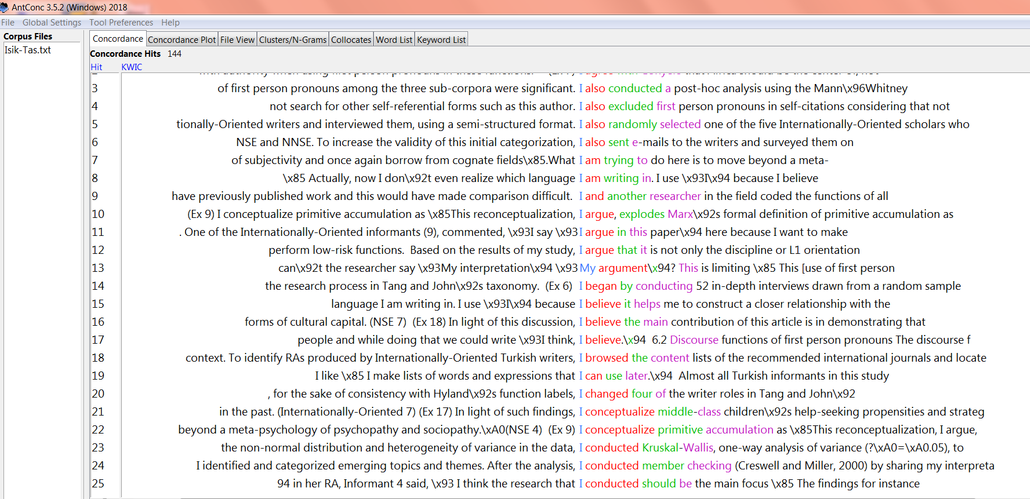
Students can conduct corpus analysis

Slide 39
Students can conduct corpus analysis
compare the frequency of first person pronouns across corpora of selected RAs from different journals in their first language and in English
read and reflect on example concordance lines retrieved from these corpora and discuss questions like “What might the author’s aim be in using or avoiding first person pronouns in this example?”
In light of such findings, I conceptualize middle-class children’s help-seeking propensities and strategies as forms of cultural capital.

Slide 40

Students develop hypotheses
develop their own hypotheses about the use of first person pronouns in their disciplines and then interview discipline-specific faculty members to test these hypotheses.
discuss their findings in class or reflect on them by writing diaries.

Slide 41
Writing is a socially developed skill.
Academic writers develop their authorial self by making discoursal choices that are available to them.
“Academic writers have rhetorical options and there are considerable advantages for them in being aware of the preferred patterns of expression in different communities.” (Hyland, 2001, p. 224),

Slide 42
Işık-Taş, E. E. (2018). Authorial identity in Turkish language and English language research articles in Sociology: The role of publication context in academic writers’ discourse choices. English for Specific Purposes 49(1), 26-38.
edaisik@metu.edu.tr

Slide 43
Thank You!
Any comments or questions?

Slide 44
References
Bartholomae, D. (1985). Inventing the university. In Rose, M. (Ed). When a Writer can’t Write: Studies in Writer’s Block and Other Composing Problems (pp. 134–165). New York: Guilford Press.
Biber, D, Johannsson, S., Leech, G., Conrad, S., Finegan, E. (1999). Longman Grammar of Spoken and Written English. Pearson Education Limited. Essex.
Duff, P. A. (2007a). Problematising academic discourse socialization. In Marriott, H; Moore, T; Spence-Brown, R. (Eds). Learning Discourses and the Discourses of Learning (pp. 1.1–1.18). Melbourne: Monash University ePress.. DOI: 10.2104/ld070001.
Duff, P. A. (2007b) Second language socialization as sociocultural theory: Insights and issues. Paper presented at the Pacific Second Language Research Forum (PacSLRF) and Australian Association of Applied Linguistics joint conferences at the University of Queensland, Australia, July 2006.
Garrett, P. B. & P. Baquedano-Lopez. (2002). Language socialization: Reproduction and continuity, transformation and change. Annual Review of Anthropology 31, 339–361.
Hyland, K. (2002). Authority and invisibility: authorial identity in academic writing. Journal of Pragmatics 34, 1091-1112.
Ivanic ́,Roz,1998.Writing and Identity: The Discoursal Construction of Identity in Academic Writing. Benjamins, Amsterdam.
Tang, Ramona, John, Suganthi, 1999. The ‘I’ in identity: exploring writer identity in student academic writing through the first person pronoun. English for Specific Purposes 18, S23–S39.
Wertsch, J. (1991). Voices of the Mind: A Sociocultural Approach to Mediated Action. Hemel Hempstead: Harvester Wheatsheaf.

